Slide 1
Ethical Hacking
BY Arsalan Akmal

Slide 2
Topic
Email and Domain Information Gathering
- Metadata Analysis
WHOIS Data and Domain Ownership
- DNS Enumeration
Enumeration of Network Services
Hands-on Practice with an Information Gathering

Slide 3
Email & Domain Information Gathering
Information Gathering is the process of collecting essential data about the target domain or network. Information can be of various types, like subdomains of the target domain, DNS Information, Port Information, ownership details, registration dates, server locations, and security configurations etc.

Slide 4
Examples:
1. WHOIS Lookup:
Performing a WHOIS lookup on example.com to find out the registrant's contact information, registration date, and expiration date.
Syntax on Linux :
─$ whois google.com

Slide 5
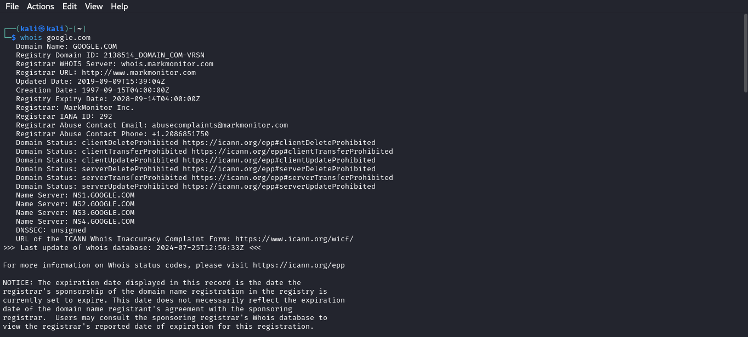

Slide 6
Examples:
2. DNS Records Analysis:
Retrieving the TXT records for example.org to identify SPF (Sender Policy Framework) settings that help in preventing email spoofing.

Slide 7
Techniques and Tools/Websites
WHOIS Lookup:
Techniques:
Query WHOIS databases to get domain registration details.
Tools/Websites:
Command: whois example.com
Website: https://lookup.icann.org/en/lookup

Slide 8
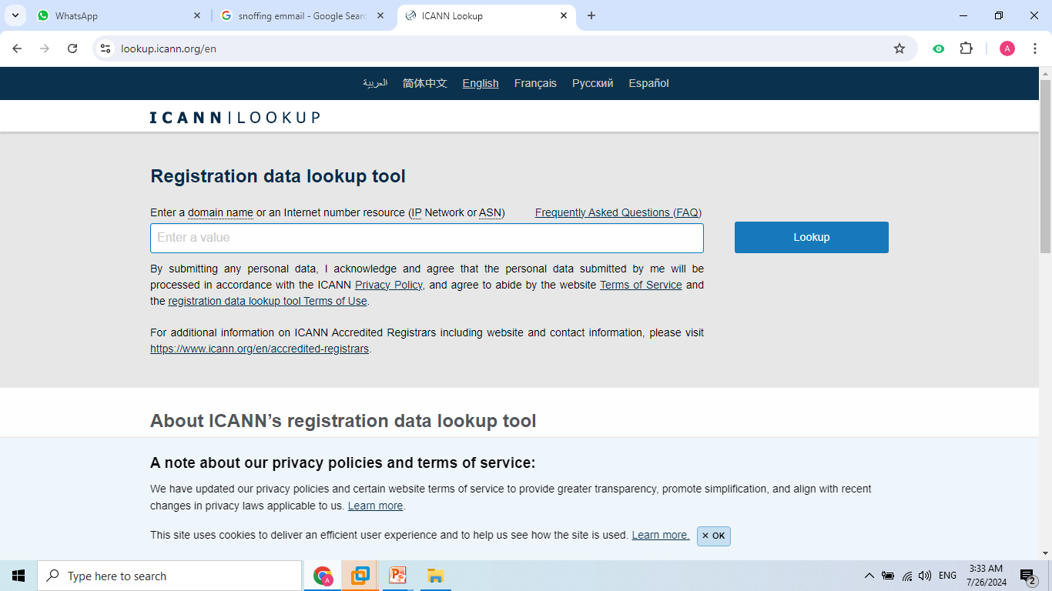

Slide 9
Techniques and Tools/Websites
DNS Records Analysis:
Techniques:
Use DNS query tools to extract various DNS records like A, MX, NS, TXT, etc.
Tools/Websites:
Command: dig example.com MX
Command: nslookup -type=TXT example.com
Website: MXToolbox

Slide 10
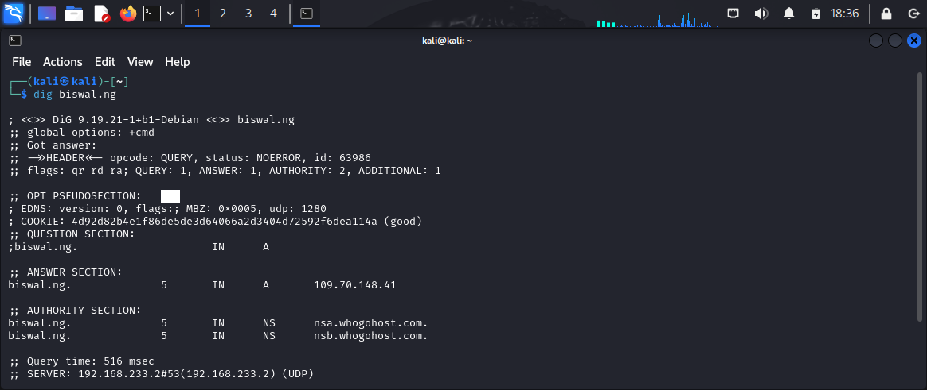
Command: dig example.com MX

Slide 11
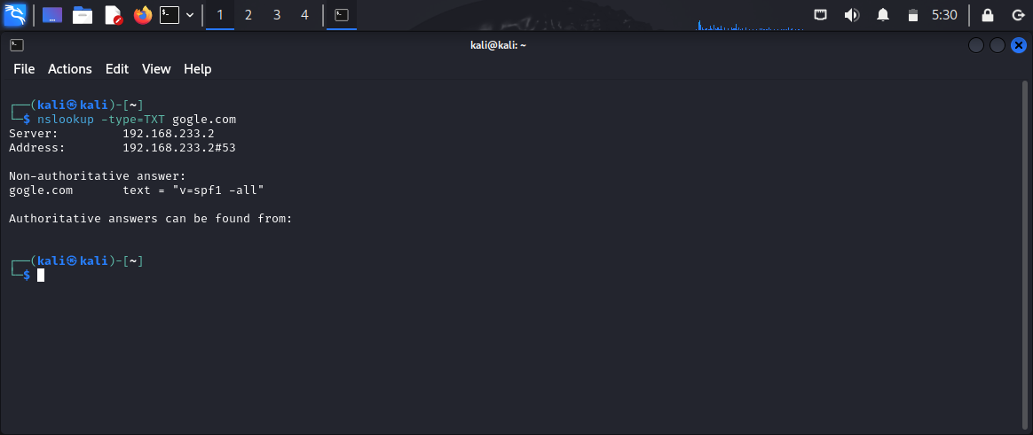
Command: nslookup -type=TXT example.com

Slide 12
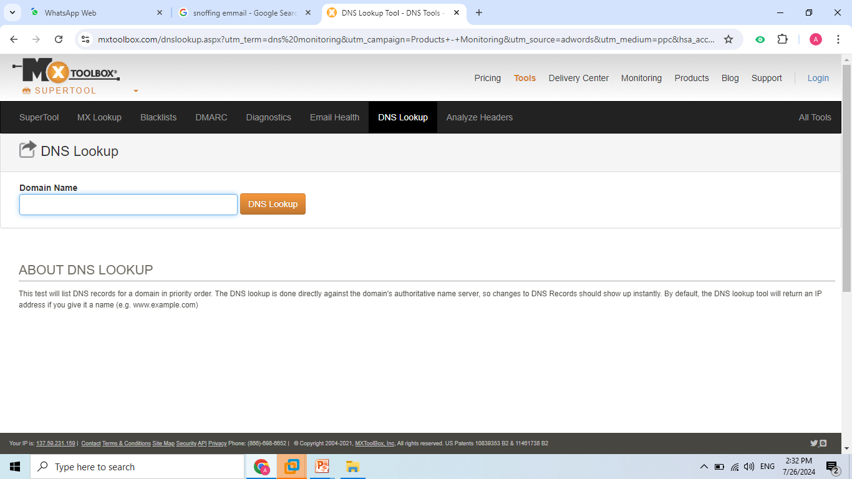
Website: MXToolbox

Slide 13
Email Address Search:
Techniques: | Search for email addresses associated with a domain using public databases and search engines.
Tools/Websites:
Tool: theHarvester Syntax theHarvester -d example.com -b google
Website: Hunter.io

Slide 14
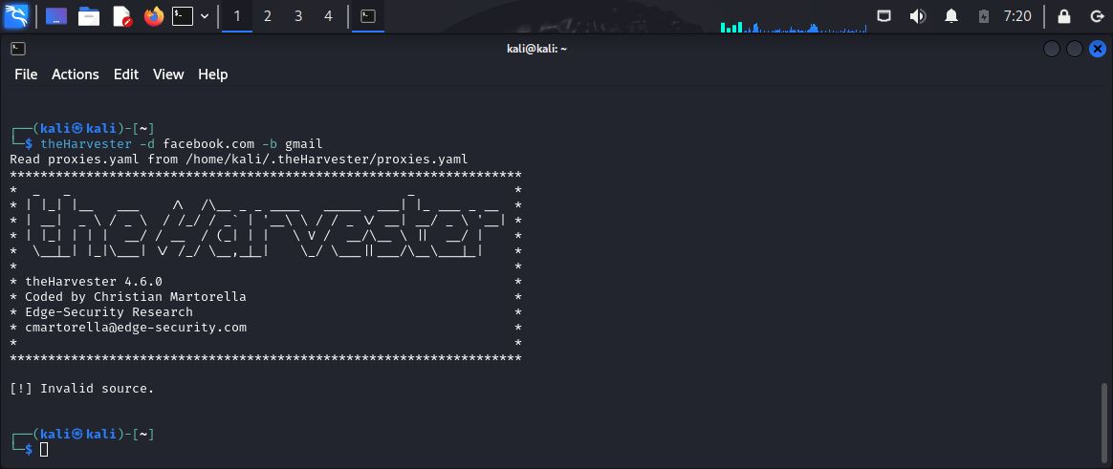
$ theHarvester -d example.com -b google

Slide 15
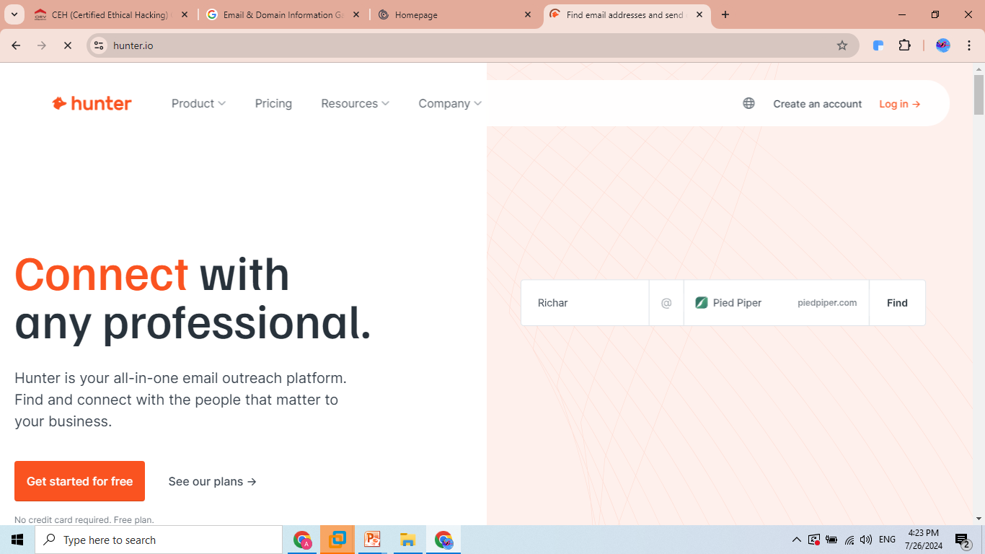
Website: Hunter.io

Slide 16
Reverse Email Lookup:
Techniques: Use reverse lookup tools to find out information about an email address.
Tools/Websites:
Website: Pipl
Website: Spokeo

Slide 17
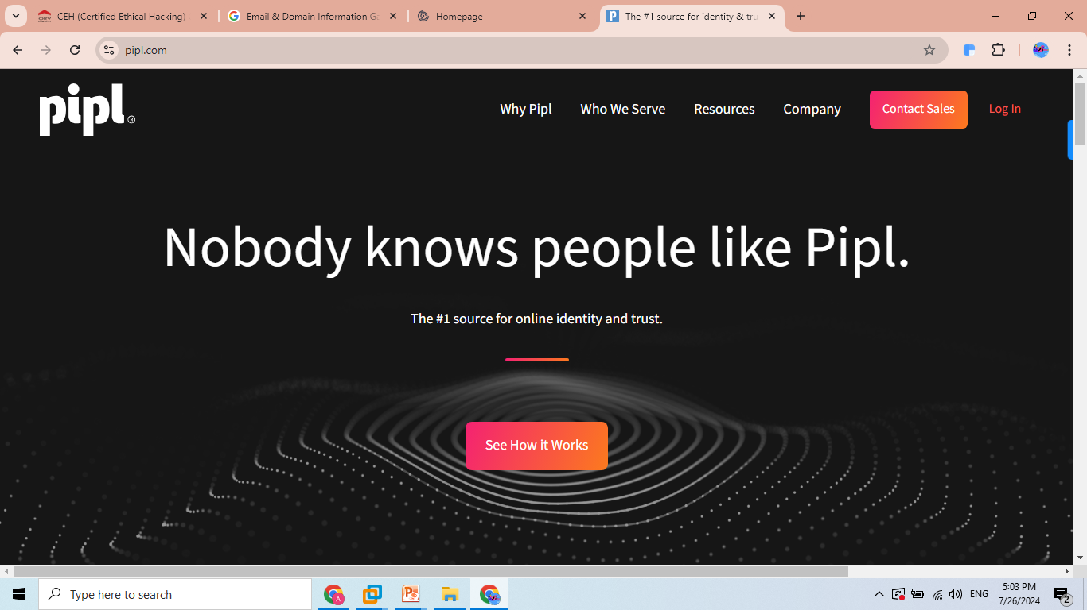
Website: Pipl

Slide 18
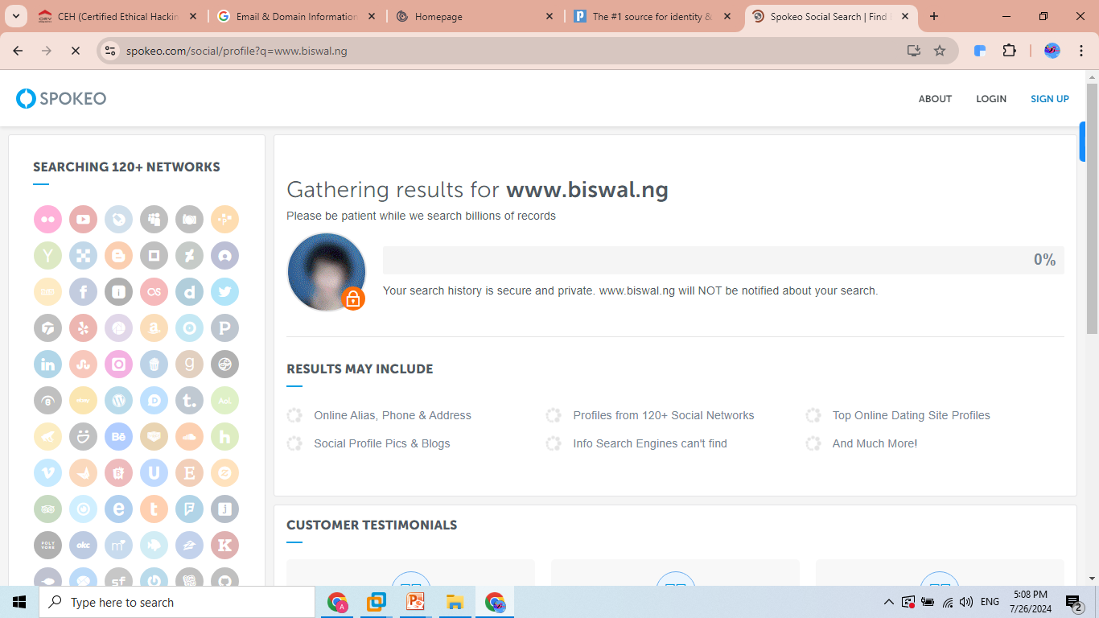
Website: Spokeo

Slide 19
Metadata Analysis
Metadata analysis involves extracting and examining metadata from files and documents. Metadata can include information about the file creation date, author, software used, and other details that are embedded within the file.

Slide 20
Examples
1. Document Metadata Extraction:
Example: Extracting metadata from a PDF file to find out the author, creation date, and software used to create the document.
Example: Analyzing the metadata of a Word document to discover revision history and hidden comments.
2. Image Metadata Analysis:
Example: Extracting EXIF data from a JPEG image to find out the camera model, GPS location, and date/time the photo was taken.
Example: Analyzing metadata from a PNG image to determine editing software and file creation details

Slide 21
Techniques and Tools/Websites
Document Metadata Extraction:
Techniques: Use metadata extraction tools to read and analyze metadata from documents.
Tools/Websites:
Tool: exiftool Syntax: exiftool document.pdf
Tool: FOCA( need to be install) Syntax: foca-cli -f document.pdf

Slide 22
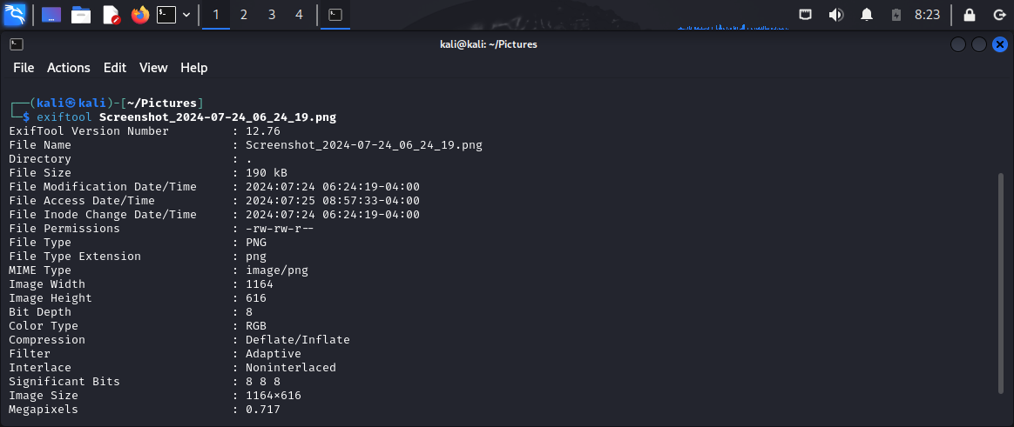
Syntax: exiftool document.pdf

Slide 23
Image Metadata Analysis:
Techniques: Extract and analyze EXIF data from images to gather information about the image creation and modification.
Tools/Websites:
Tool: exiftool exiftool image.jpg
Website: Jeffrey's Image Metadata Viewer

Slide 24
Online Metadata Analyzers:
Techniques:
Upload files to online services that can extract and display metadata.
Tools/Websites:
Website: Get-Metadata
Website: Metashield Analyzer

Slide 25
DNS Enumeration
DNS enumeration is the process of collecting detailed information about a domain's DNS (Domain Name System) records. This can include various types of records such as A (address), MX (mail exchange), NS (name server), TXT (text), CNAME (canonical name), and others. DNS enumeration helps in understanding the structure and configuration of a domain's DNS.

Slide 26
Examples
1. Retrieving MX Records:
Example: Performing a DNS query to obtain the MX records for example.com reveals the mail servers responsible for handling email for the domain.
Example: Using DNS enumeration to find out the backup mail servers listed in the MX records for anotherdomain.org.
2. Listing Subdomains:
Example: A DNS enumeration process reveals subdomains like mail.example.com, ftp.example.com, and shop.example.com, providing insights into the domain's structure.
Example: Discovering hidden subdomains such as dev.example.com or test.example.com that are not publicly advertised but exist in the DNS records.

Slide 27
Techniques and Tools/Websites
DNS Queries:
Techniques: Use DNS query tools to extract various DNS records.
Tools/Websites:
Command: dig example.com ANY
Command: nslookup -type=ANY example.com
Website: MXToolbox
DNS Enumeration Tools:
Techniques: Utilize specialized tools to perform comprehensive DNS enumeration and gather all related records.

Slide 28
Tool: dnsenum | dnsenum example.com
Tool: dnsrecon | dnsrecon -d example.com
Tool: fierce | fierce -dns example.com

Slide 29
Subdomain Enumeration:
Techniques: Discover subdomains associated with a domain using enumeration tools and brute force techniques.
Tools/Websites:
Tool: sublist3r Syntax sublist3r -d example.com
Tool: amass Syntax amass enum -d example.com
Website: VirusTotal (for discovering subdomains via DNS records)

Slide 30
Enumeration of Network Services
Enumeration of network services involves the process of identifying active services running on a network, such as web servers, FTP servers, email servers, and other types of networked applications. This is typically done by scanning for open ports and then probing these ports to determine what services are running and what versions of the software are in use. This step is crucial in both network administration for security assessment and penetration testing to identify potential vulnerabilities.

Slide 31
Examples
1- Port Scanning:
Example: Scanning a network using Nmap reveals that ports 22 (SSH), 80 (HTTP), and 443 (HTTPS) are open on a server, indicating that these services are running.
Example: A network scan shows that port 3306 (MySQL) is open on a database server, providing insight into the services that could be targeted or secured

Slide 32
Examples
Service Version Detection:
Example: Using Nmap with version detection (-sV), it is identified that the HTTP service on port 80 is running Apache 2.4.41.
Example: A version scan reveals that the SSH service on port 22 is running OpenSSH 7.9, which can then be checked for known vulnerabilities.

Slide 33
Techniques and Tools/Websites
1. Port Scanning:
Techniques: Scanning a network for open ports to identify active services.
Tools/Websites:
Nmap: nmap -p 1-65535 example.com
Masscan (for very large networks or fast scans): masscan -p1-65535 192.168.1.0/24

Slide 34
Techniques and Tools/Websites
2. Service Version Detection:
Techniques: Scanning open ports to detect the software and version running on those ports.
Tools/Websites:
Nmap with version detection: nmap -sV example.com
Banner Grabbing with Netcat: nc -v example.com 80

Slide 35
Thank You.

